Slide 1

Mongol Conquests Golden Horde
Lecture #9

Slide 2

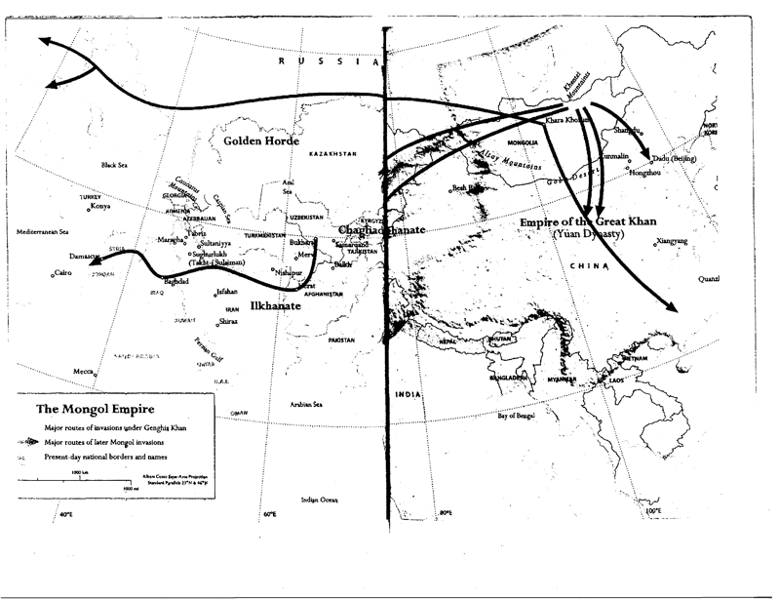
The Mongol Empire (1206-1368)
Notes:
Conquests of Mongols

Slide 4
Pax Mongolica
The term “Pax Mongolica” (1250-1350) refers to the time when the Mongol Empire, founded by Genghis Khan, controlled much of the Eurasian continent. At its height, the Mongol Empire spanned from the east coast of Eurasia in China all the way to Eastern Europe. Its size made that state the largest contiguous empire on land in recorded history.
The Mongols conquered these lands by force. However, they were more interested in collecting taxes from the conquered population rather than converting them to their ways. As a result, the Mongol rulers allowed for relative religious and cultural freedom. For a time, Pax Mongolica provided stability and relative peace for trade and intercultural communication.

Slide 5
Legacy of chinggis Khan(1162-1227)
One of Chinggis Khan's greatest legacies was the principle of religious tolerance. In general, Chinggis provided tax relief to Buddhist monasteries and to a variety of other religious institutions. And though Chinggis himself never converted to any of the religions of the sedentary peoples he conquered (he remained loyal to Mongolian shamanism), he was quite interested in Daoism, particularly because of the Daoists' pledge that they could prolong life.
The creation of the first Mongol written language was another legacy of Chinggis Khan. In 1204, even before he gained the title of "Chinggis Khan," Chinggis assigned one of his Uyghur retainers to develop a written language for the Mongols based upon the Uyghur script
A third legacy was Chinggis's support for both trade and crafts, which meant support for the merchants and artisans in the business of trade and craft. Chinggis recognized early on the importance of trade and crafts for the economic survival of the Mongols and actively supported both.
Chinggis also left behind a legal code, the so-called Jasagh, which consisted of a series of general moral injunctions and laws. The Jasagh also prescribed punishments for transgressions of laws relating particularly to pastoral-nomadic society.

Slide 6
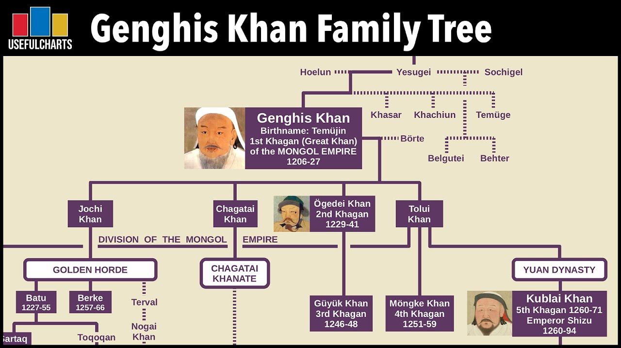

Slide 7
Golden Horde (1227 – 1502)
Chinggis Khan granted the lands of what is today southern Russia and Kazakhstan to his eldest son Jochi’s second son Batu, who eventually became ruler of the Blue Horde, and his elder brother Orda, who became the leader of the White Horde.

Slide 8
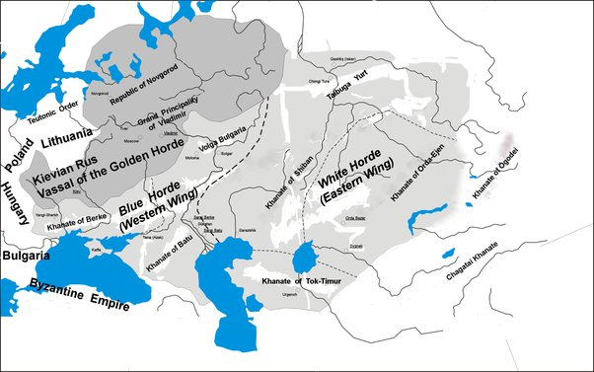

Slide 9
Adoption of Islam 1313
Berke Khan (1258-1266) son of Batu
Uzbek Khan (1313-1341) promoted Islam to the state religion of the Golden Horde

